Slide 1
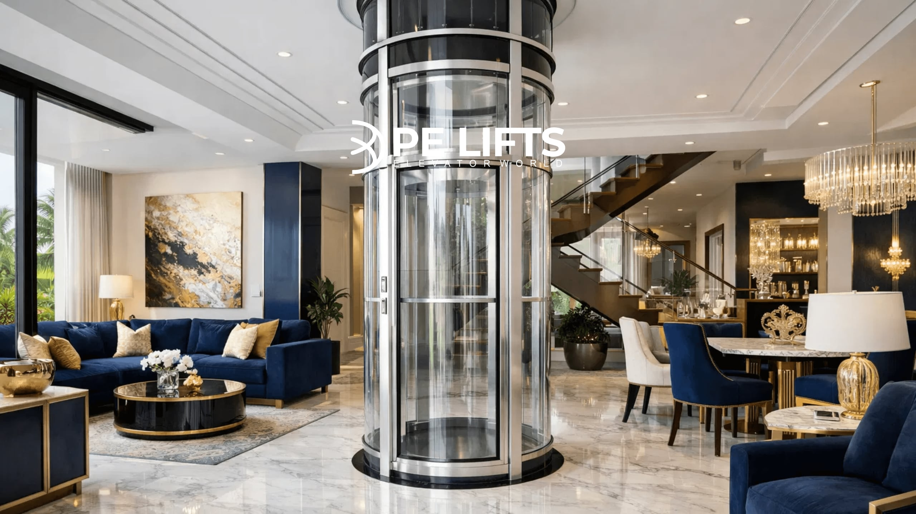


PE LIFTS GHANA
The Future of Vertical Mobility

Slide 2

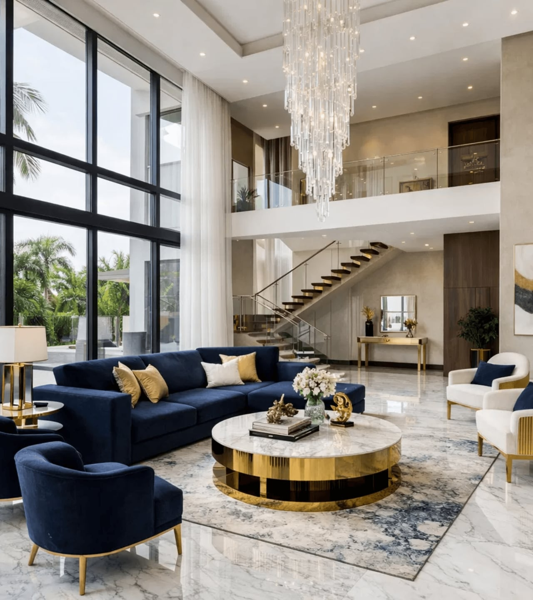



West Africa’s Premier Partner in Advanced Mobility
PE Lifts Ghana is the authorized distributor of advanced pneumatic vacuum elevators, bringing European engineering excellence to Ghana's most prestigious homes. We specialize in seamless integration of luxury mobility solutions.
CERTIFICATION
INSTALLATION
24/7 SUPPORT

Slide 3

Why Vacuum Technology Outperforms Traditional Systems
FEATURE
VACUUM ELEVATOR
TRADITIONAL SYSTEMS
Pit & Machine Room
Not Required
Mandatory (Deep Pit)
Energy Consumption
Eco-friendly (Gravity Descent)
High Power Demand
Installation Time
1-3 Days
1-4 Weeks
Aesthetics
360° Panoramic View
Enclosed Box
"No pit, no machine room, low energy—the ultimate choice for modern villas."

Slide 4

A Model for Every Architectural Vision
SINGLE PASSENGER
TWO PASSENGERS
PVE 30
PVE 37
The world's smallest elevator, designed for tight spaces and existing homes without compromising on luxury.
Our most popular model, balancing passenger comfort with architectural elegance for standard luxury homes.
WHEELCHAIR ACCESSIBLE
PANORAMIC DESIGN
PVE 52
THE CUBE
Spacious three-passenger design, fully wheelchair accessible for the ultimate in inclusive home mobility.
Revolutionary square panoramic design that redefines modern aesthetics with 360-degree visibility.

Slide 5

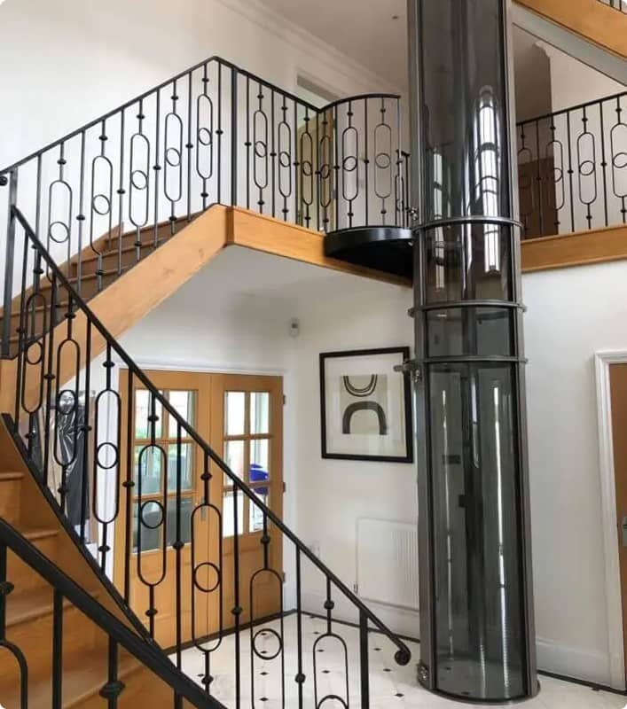
PVE 30: The Ultimate Space-Saving Solution
Capacity
1 Person (159 kg / 350 lbs)
Diameter
750 mm (30 inches)
Max Rise
15 Meters (5 Stops)
Speed
9 meters/min (30 fpm)
SPACE EFFICIENCY INSIGHT
The PVE 30 fits where no other elevator can. With a minimal footprint, it is the ideal choice for existing duplexes and townhouses where space is at a premium.

Slide 6
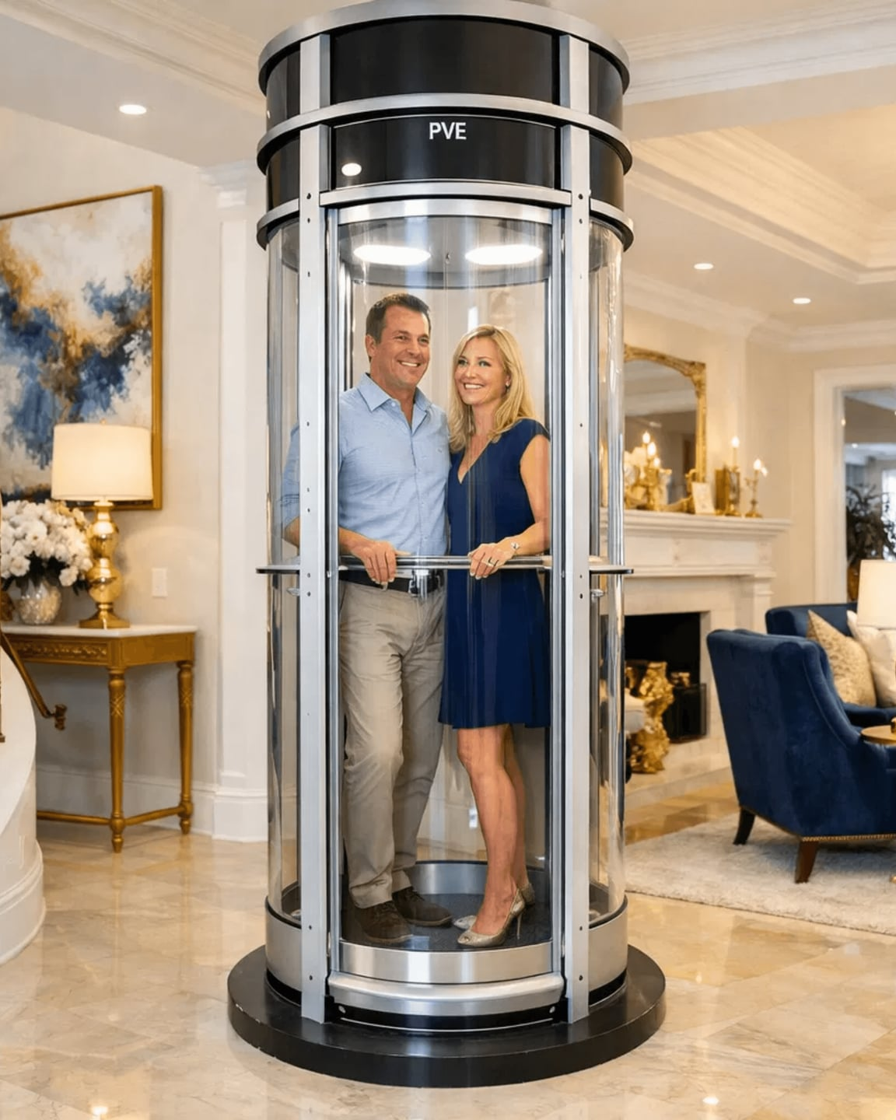

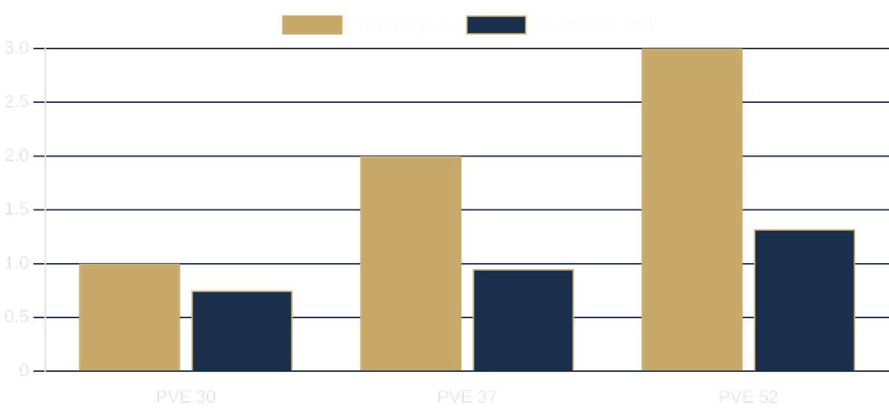
PVE 37: The Standard of Excellence in Home Mobility
Capacity
2 Persons (205 kg / 450 lbs)
External Diameter
950 mm (37 inches)
Max Rise
15 Meters (5 Stops)
Key Features
Optional fold-up seat, 360° visibility
EFFICIENCY: PASSENGER CAPACITY VS. FOOTPRINT

Slide 7

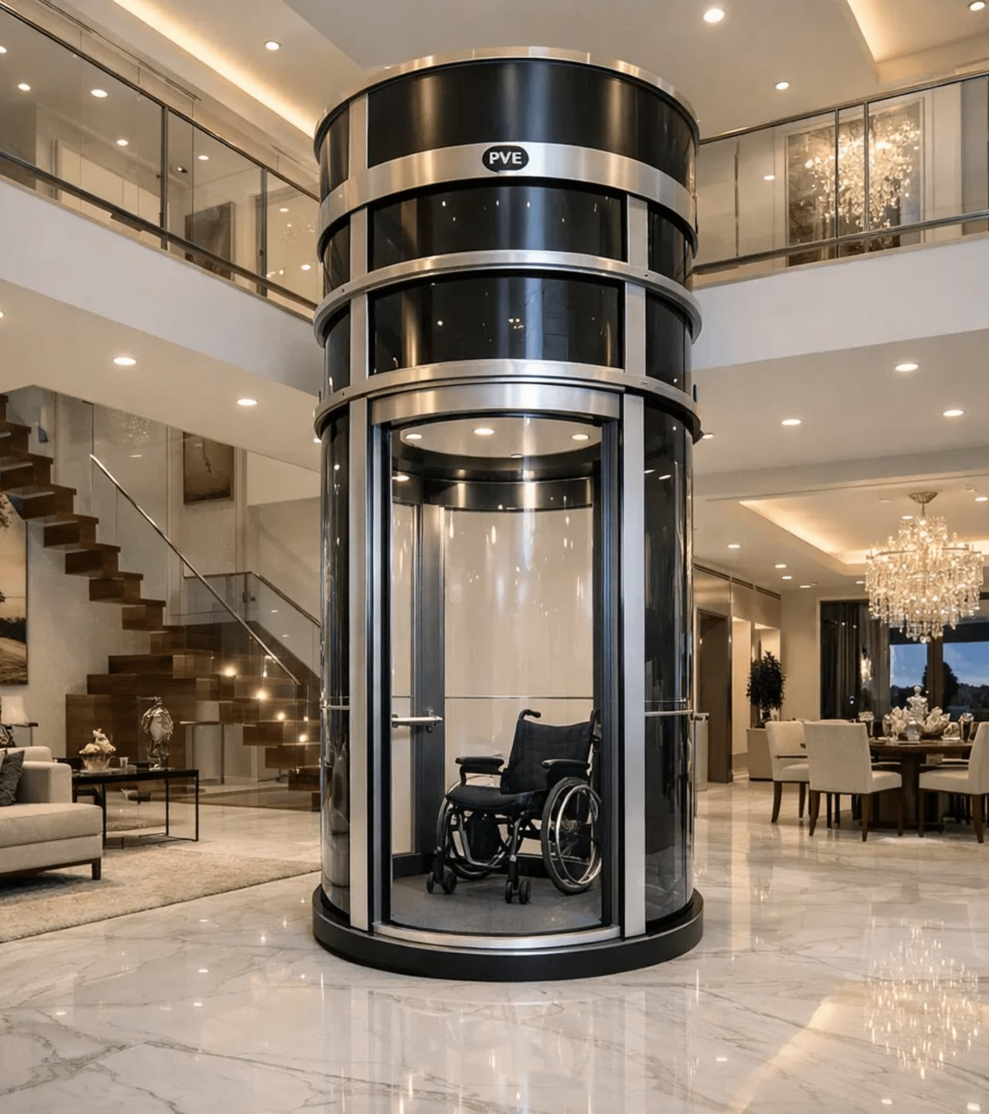
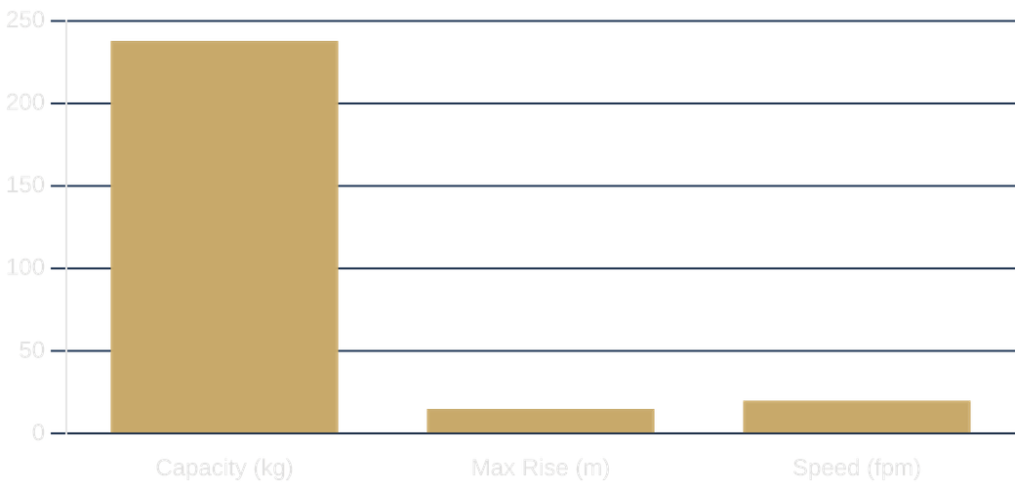
PVE 52: Unmatched Capacity and Accessibility
Capacity
3 Persons / Wheelchair (238 kg)
External Diameter
1316 mm (52 inches)
Max Rise
15 Meters (5 Stops)
Speed
6 meters/min (20 fpm)

Slide 8
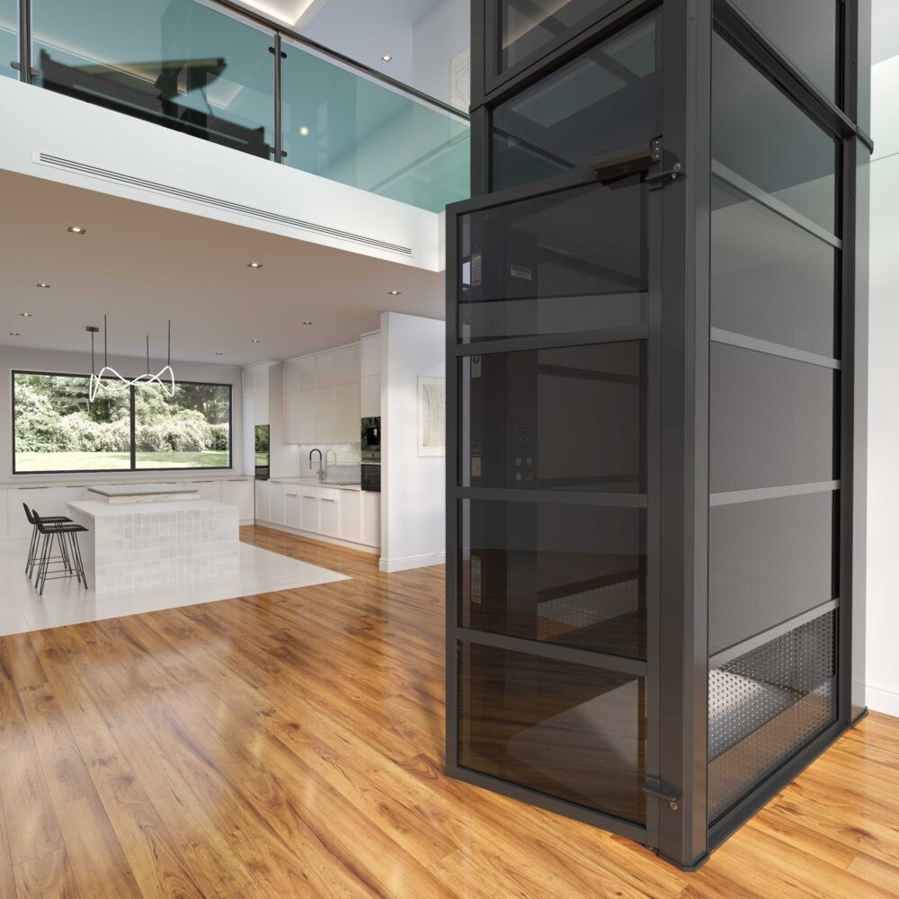




THE CUBE: REDEFINING MODERN ARCHITECTURAL DESIGN
Square Panoramic Design
Symmetrical lines and a bold geometric profile that seamlessly complements contemporary luxury interiors.
360° Unobstructed Visibility
High-quality transparent polycarbonate panels offer breathtaking views and enhance the sense of space.
Advanced Pneumatic Power
Driven entirely by air pressure, eliminating the need for unsightly cables, pulleys, or heavy machinery.
"The world's first square pneumatic elevator—where engineering meets high-end architectural art."

Slide 9
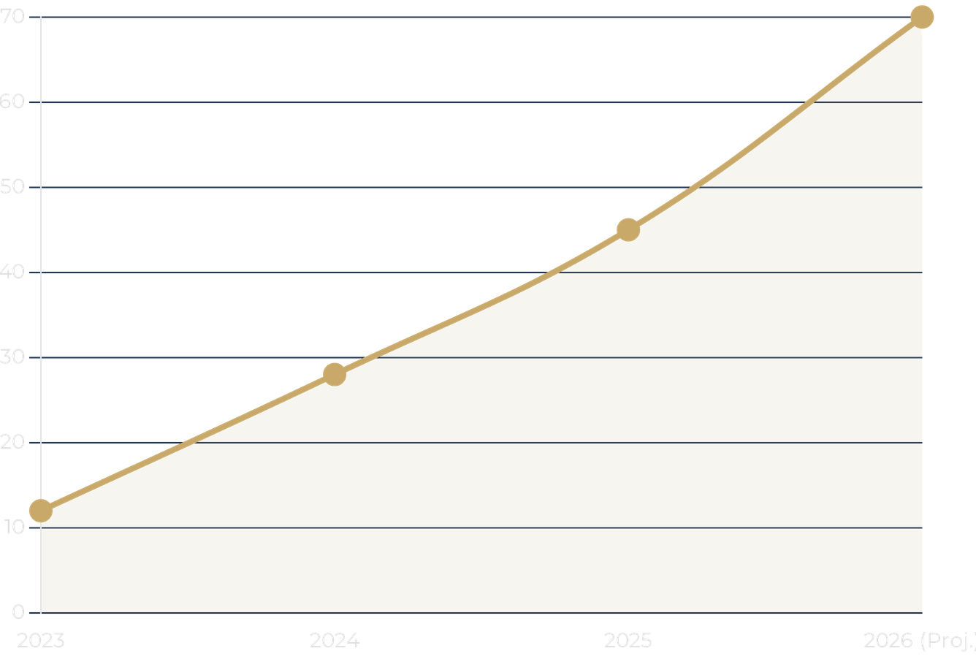
RESIDENTIAL INSTALLATION GROWTH TREND
OUR GROWING PRESENCE ACROSS GHANA
PE Lifts Ghana is the trusted choice for luxury developments in Accra, Kumasi, and beyond, reflecting the rising demand for premium home mobility.
150%
INSTALLATION GROWTH (2023-2026)

Slide 10




ELEVATE YOUR HOME TODAY
Partner with PE Lifts Ghana for a seamless, luxury elevator experience.
VISIT US
CALL US
ONLINE
No. 990 block, Adjiringano Rd,
Accra, Ghana
+233 557 03 02 04
www.pelifts.com

